Slide 1
Mixture of Functional Linear Models
Introduction to Data Mining (DATS 6103)
By:
Upmanyu Singh
Shikha Sharma
Sanchit Vijay

Slide 2
Data Collection
Used the library ‘wbgapi’ for collection of the data.
Dependent variable or response variable is CO2 per capita.
GDP per capita is the covariate.
Data consist of years from 1994 to 2021 for 56 countries.

Slide 3
Data Preprocessing
Removing the columns with more than 25 null values
Filling nan with knn imputation technique
A new sample is imputed by finding the samples in the training set “closest” to it and averages these nearby points to fill in the value.

Slide 4
Functional Data Analysis

Slide 5
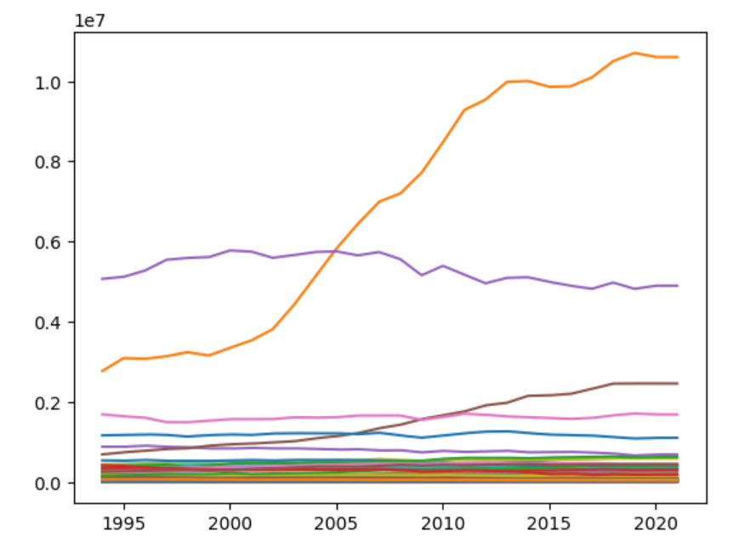
Graph of CO2 emission vs year
The graph doesn’t explain the variability of the co2 for every year. It’s because there is high difference between the values.
Graph does not explains the variability of CO2 over year

Slide 6
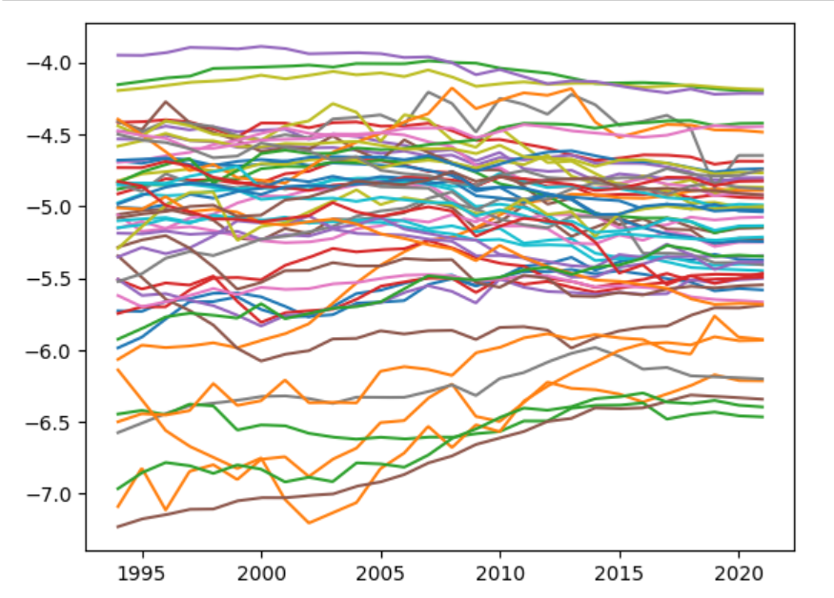
Taking Log of CO2 per capita explains the variability across years
So by taking the log of co2 per capita, we can see variability can be seen.

Slide 7
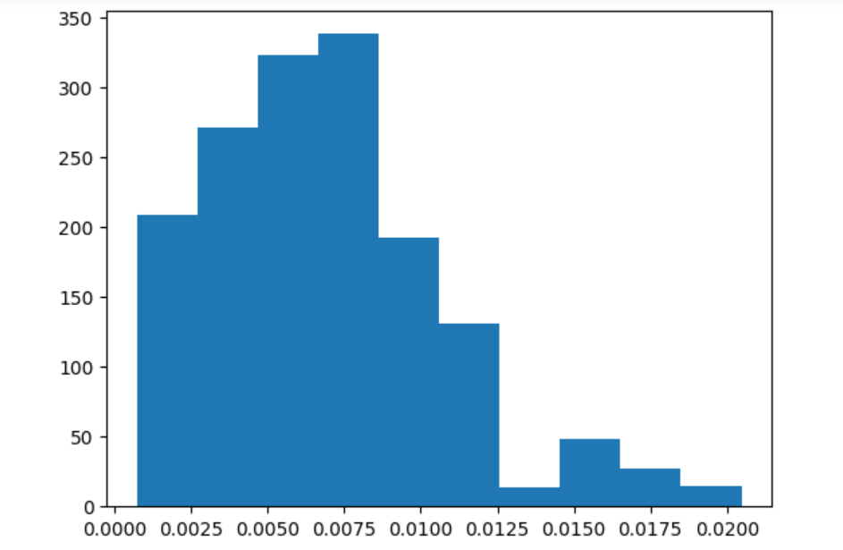
Normality of Response variable (CO2 per capita)
Response variable is co2 per capita and it is rightly skewed

Slide 8
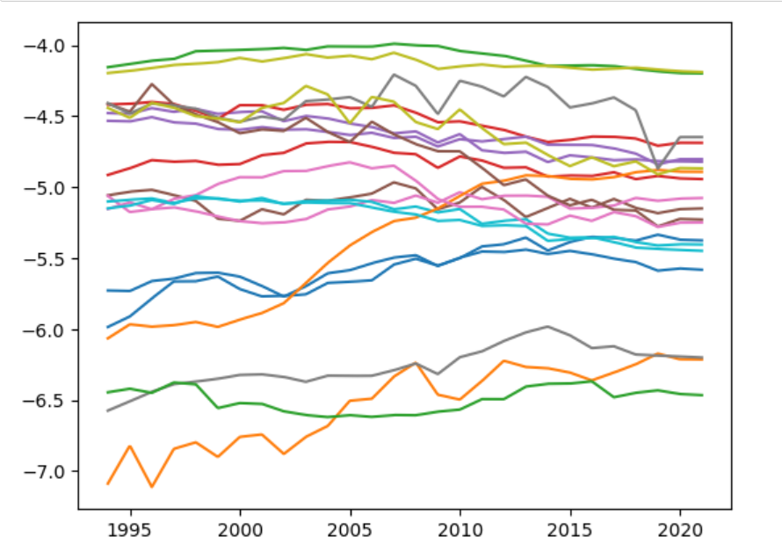
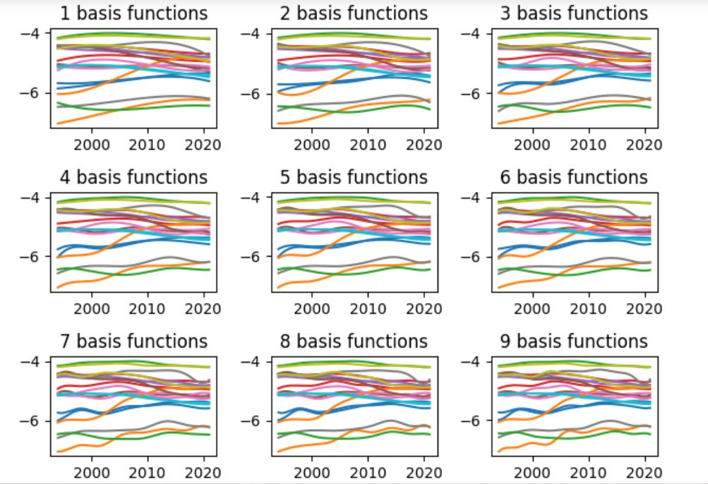
Basis Function

Slide 9
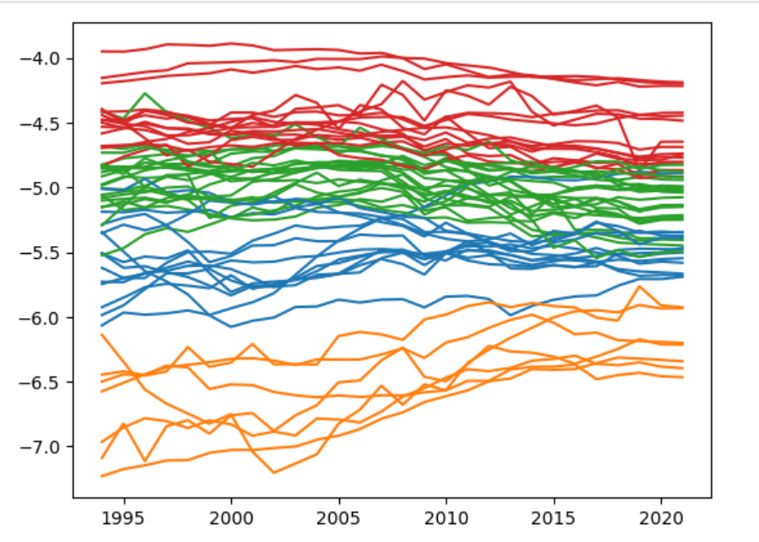
Clustering

Slide 10
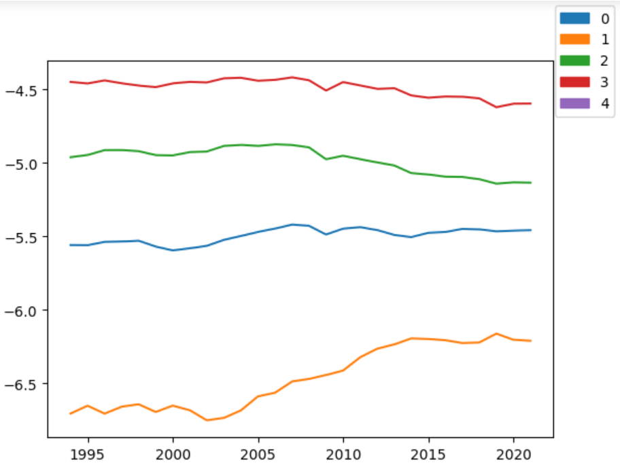

Slide 11
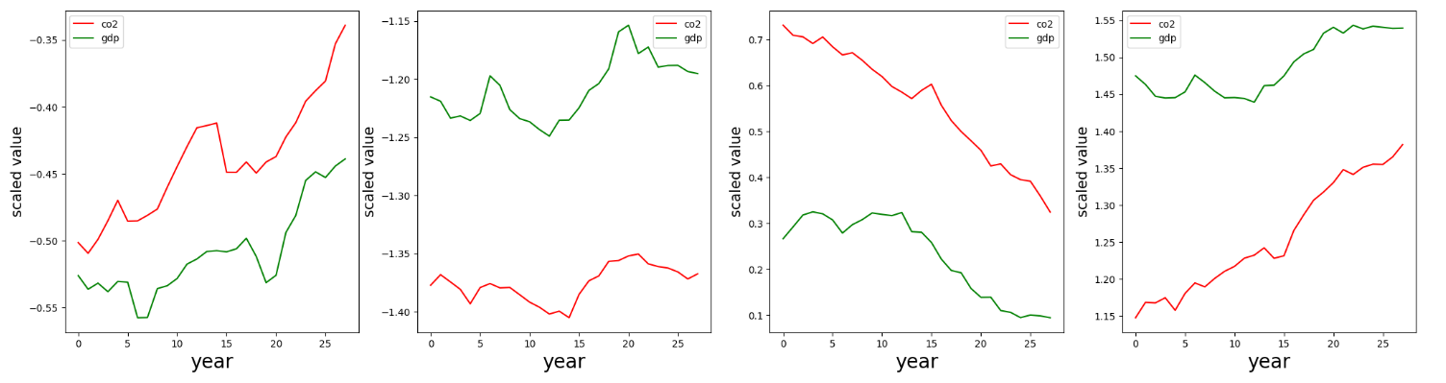
Each group showing different relation of co2-gdp
Cluster1
Cluster2
Cluster3
Cluster4
Cluster 1
Cluster 2
Cluster 3
Cluster 4
This cluster contains the developed countries and kazakhstan
Clusters is formed by grouping the cluster and taking mean of gdp and co2 per capita.

Slide 12
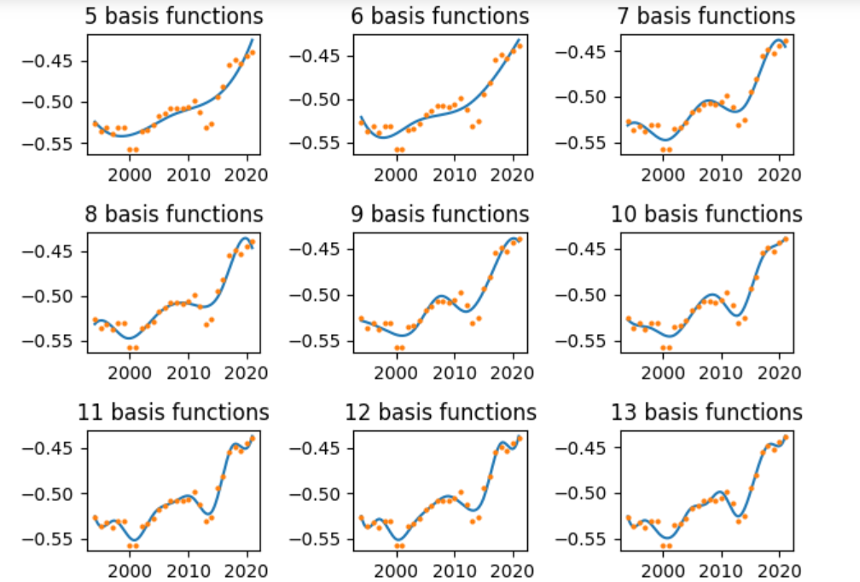
Basis representation of first cluster
This is basis representation of cluster1 and when you see that if you are increasing the basis function number the function tends to overfit with the scatter plot.

Slide 13
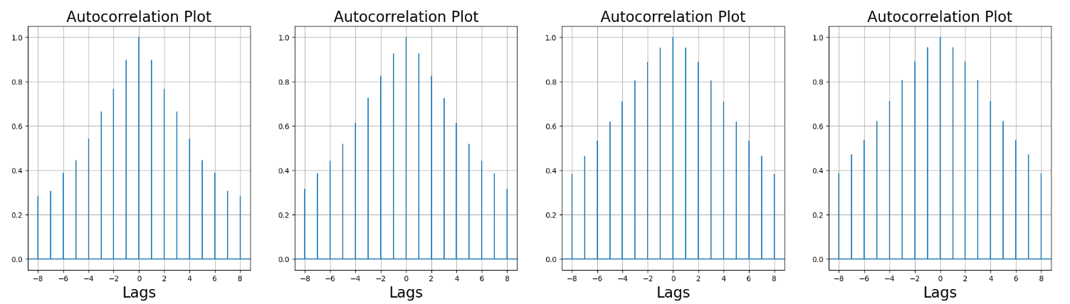
Autocorrelation plot
By selecting the basis function equal to 9 we plot the autocorrelation plot of each cluster and we can see that each cluster is having correlation with the laging term.

Slide 14
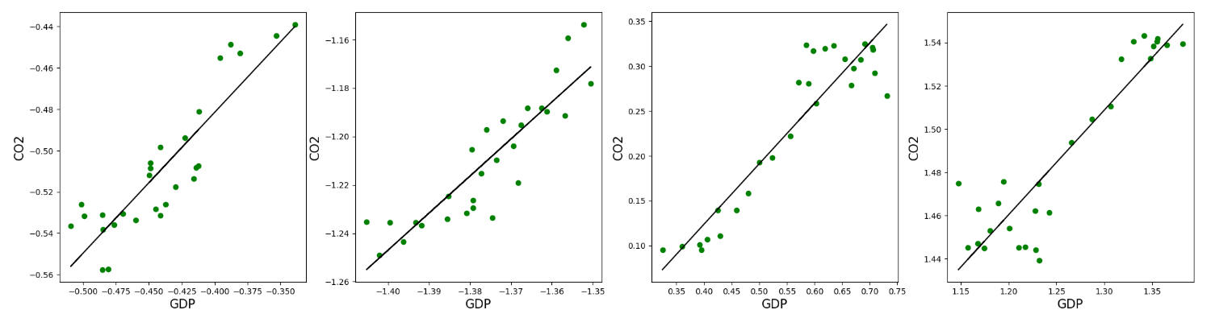
Regression plot for each cluster

Slide 15
Root Mean squared error for the each cluster
Cluster | RMSE
1 | 0.015
2 | 0.011
3 | 0.032
4 | 0.015

Slide 16
Now we are going to train model for each country and cluster their residuals and then train for the individual cluster.

Slide 17
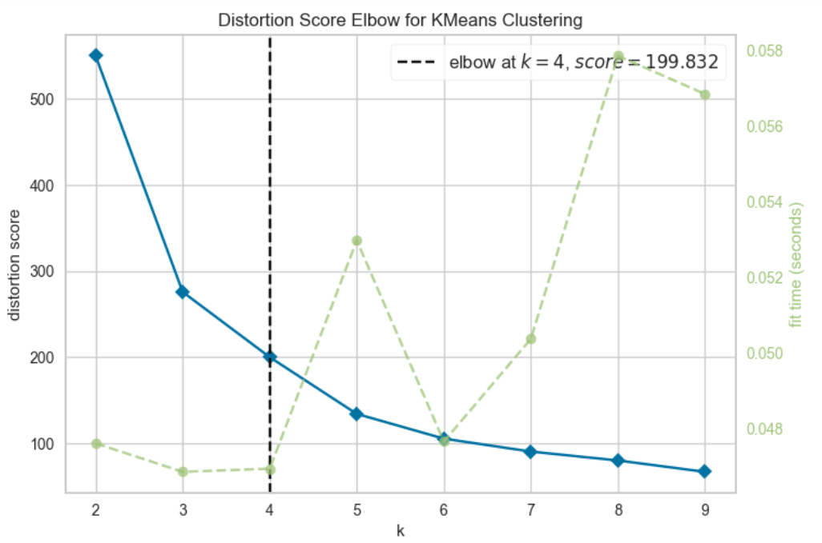
Elbow curve for finding the optimal value of N (K-means)
Optimal cluster = 4

Slide 18
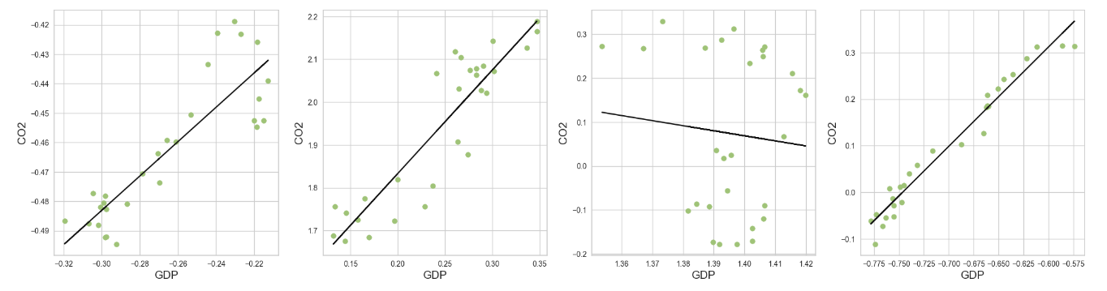
Train model for each cluster again (Linear Regression)

Slide 19
Root Mean squared error for the each cluster
Cluster | RMSE
1 | 0.011
2 | 0.07
3 | 0.18
4 | 0.026

Slide 20
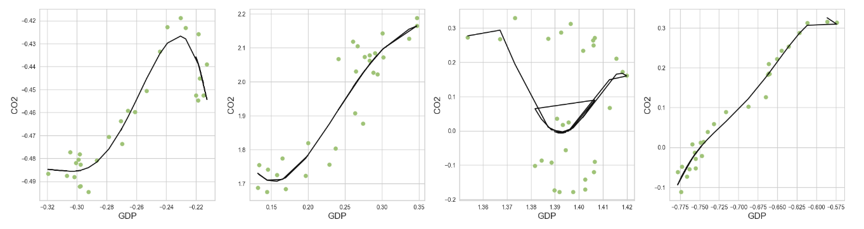
Train model for each cluster again (Polynomial Regression)
Degree=4

Slide 21
Root Mean squared error for the each cluster
Cluster | RMSE
1 | 0.007
2 | 0.068
3 | 0.16
4 | 0.021

Slide 22
Thank You
Questions ?

